Slide 1
Key Principles and Strategic Goals Utilizing the capabilities of AI in a responsible and secure manner to provide value to the business is an ongoing and gradual journey.
Security and Risk Management paramount:
Edging bets across vendor and technology
Enforce existing sound principles
Bootstrapping activities and/or filling gaps can be done through staff augmentation but …
Making sure that enterprise' data never leaked to third parties
… we are committed to grow internal capabilities in a sustainable way
Making activities auditable through on-going monitoring
Must harness and leverage the bottom-up contributions by these change agents, building internal capabilities
AI-generated artifacts never disseminated outside the firm "as is" or without a "human-in-the-loop"
NOT outsourcing what should be built strategically as differentiating strength.
Discovery and Experimentation at Core of Strategy:
.. thus… Engaging vendor strategically, i.e.,
Many want to "taste the soup" – we welcome that!
Overall, no market participants potential can be ignored yet (AWS, Azure/OpenAI, others…), so we are resisting the “urge to decide” NOT through a succession of narrow transactions
Working on streamlining how teams can get access to the AI building block in an accelerated way
Component of a larger goal of making IT services managed as well-defined product
Help brought in for thought partnership and to provide both strategic insight and scale as needed.
Harvest and Propagate Best Practices/Experience
Making Data available and AI-Ready
Must "Connect the dots" fast
Ingesting/marshalling data into AI models is often on the critical path of any AI projects.
Standardize where possible as soon as possible (but not sooner!!)
This is being addressed as a priority with work being done in Jupiter
Fostering communication is paramount
To be clear, Jupiter is NOT the overall solution to AI data in general
Several ad-hoc, self-organized groups exists – which is good - but we are working on making these connections more efficiently
Enabling Citizen Development (e.g. PowerApps platform for business users)
Harvesting this emerging know-how + combined with top-down research is how we publish standards and general best-practices. And creating building blocks that can be used across the firm
1

Slide 2
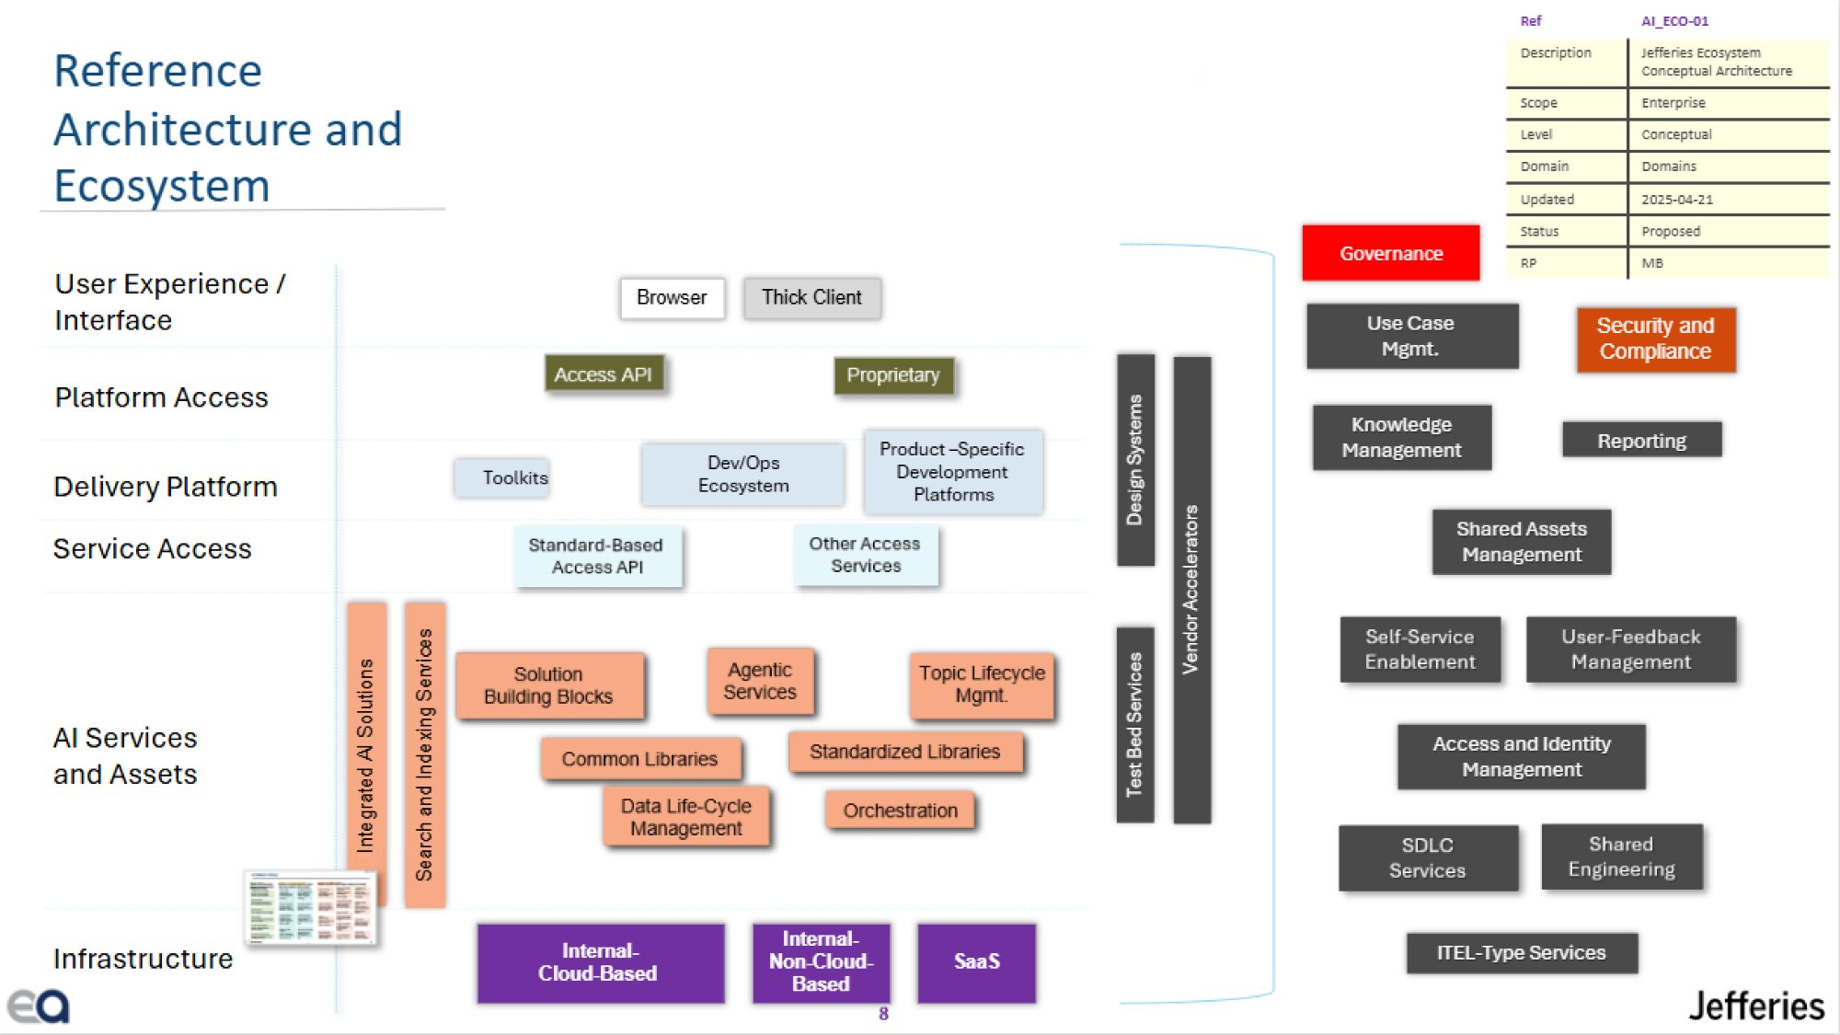

Slide 3
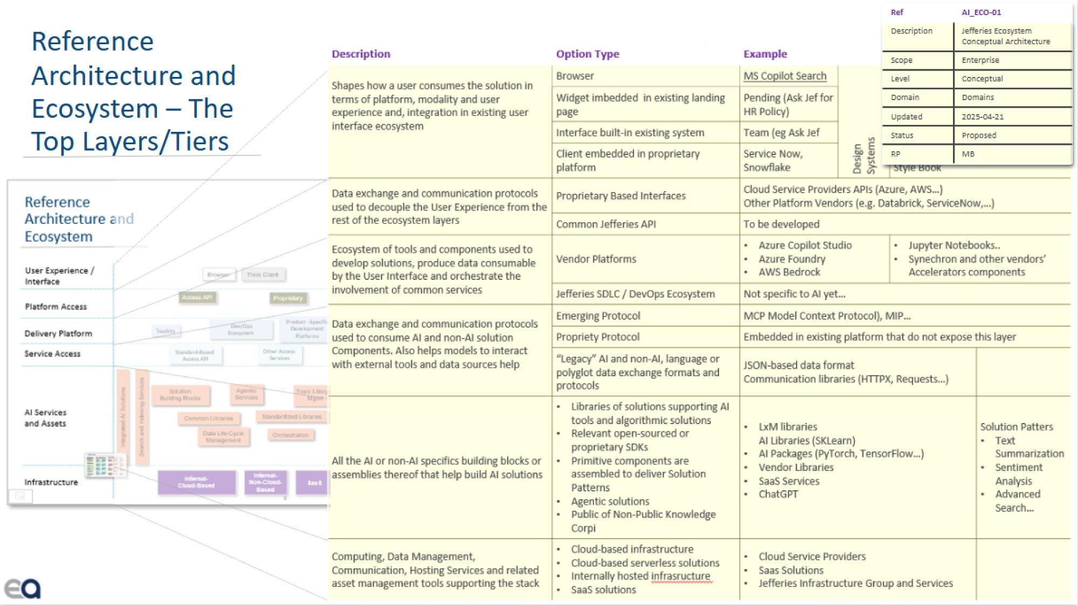

Slide 4
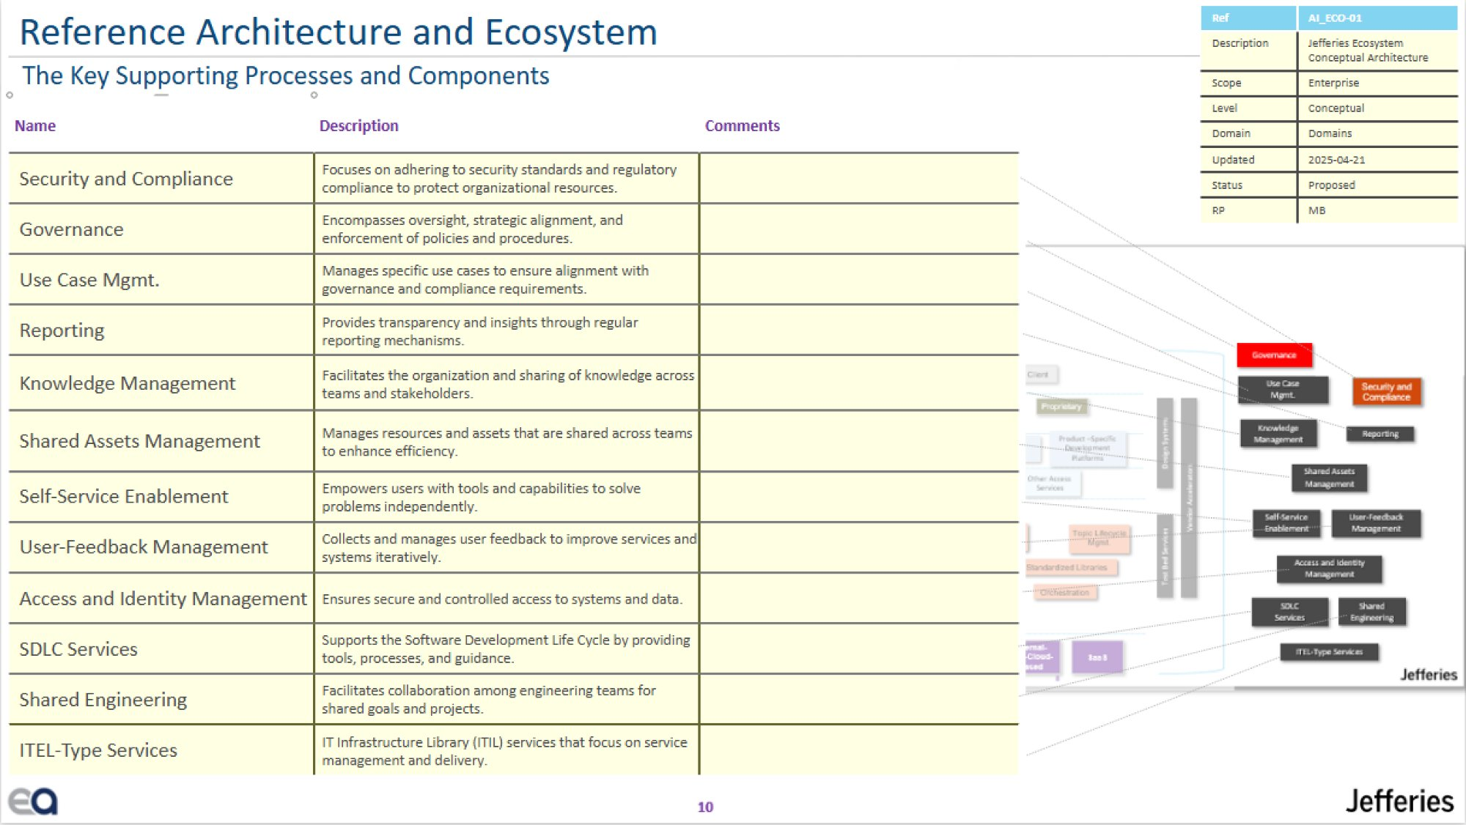

Slide 5
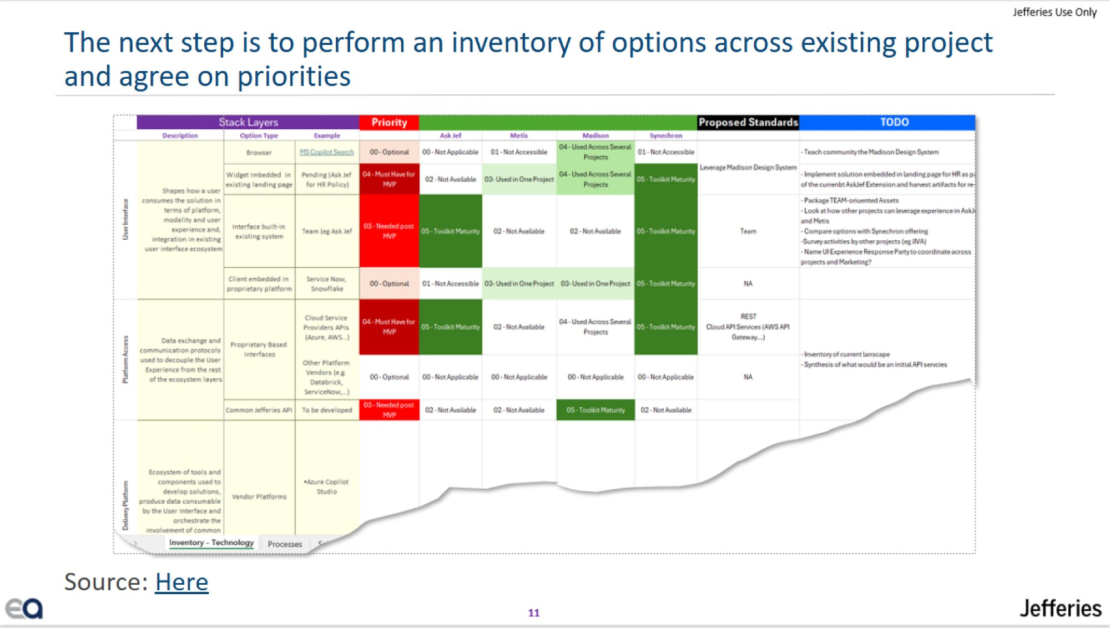

Slide 6
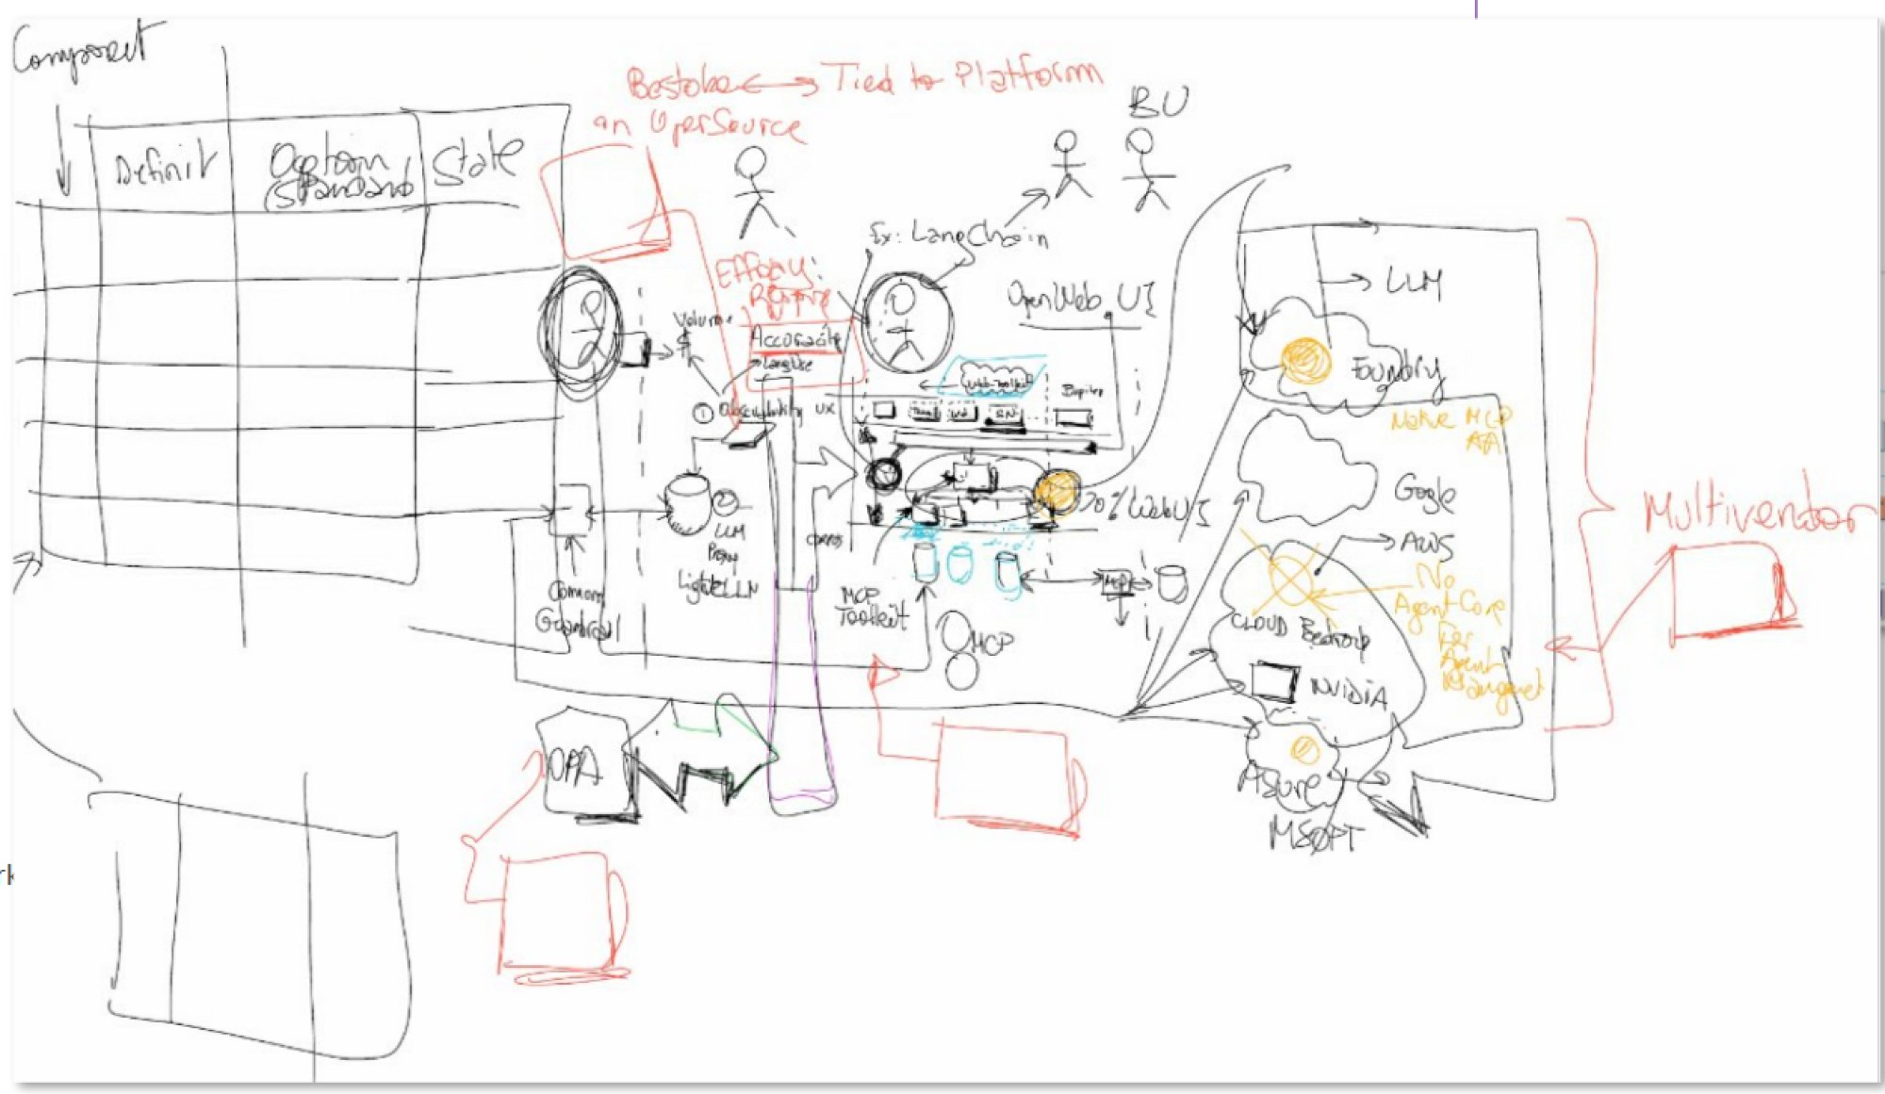

Slide 7
